Slide 1
Partnering Conference September 6, 2016
KYTC “Pause 50”
and
Cash Flow Management

Slide 2
What is “Pause 50”?
Zero new state funded authorizations in fiscal year 2017
Previous commitments may be funded
Previously authorized projects may proceed
$50 Million in new state funded authorizations in fiscal year 2018
Will be based on funding availability
Does not apply to the statewide resurfacing projects
Notes:
“Pause-50” is the Kentucky Transportation Cabinet’s (KYTC) approach to preserve and shore up the state road fund cash balance by pausing the starts of new state-funded projects in all phases (design, right of way/utilities, and construction) for the first year of the biennium; and in the second year, aim for a goal of $50 million to allocate on state-funded projects starts.
In essence, the Cabinet will “pause” adding new state-funded projects for the first year in the FY 2017 – FY 2018 biennium. This pause does not apply to the statewide resurfacing projects conducted through the KYTC maintenance program and the Rural Secondary revenue sharing program.
For the second year of biennium (FY 2018), the Pause-50 approach anticipates having approximately $50 million for state-funded projects starts. This amount could be higher or lower depending on actual state road fund expenditures and revenues.

Slide 3
How does this relate to the R/W and Utility Hold List?
$145 Million was identified as needed in the Cash Model to maintain statutory balance
Primary objective was to avoid halting active construction contracts
$245 in obligated balance in SPP R/W and Utility phases
Asked Districts to identify priority projects and those nearest construction
Most were excluded from Hold List
“Re-obligation” of these funds will be based on:
Money available from $50 Million (Pause 50)
Money transferred from other projects
Notes:
“Pause-50” is the Kentucky Transportation Cabinet’s (KYTC) approach to preserve and shore up the state road fund cash balance by pausing the starts of new state-funded projects in all phases (design, right of way/utilities, and construction) for the first year of the biennium; and in the second year, aim for a goal of $50 million to allocate on state-funded projects starts.
In essence, the Cabinet will “pause” adding new state-funded projects for the first year in the FY 2017 – FY 2018 biennium. This pause does not apply to the statewide resurfacing projects conducted through the KYTC maintenance program and the Rural Secondary revenue sharing program.
For the second year of biennium (FY 2018), the Pause-50 approach anticipates having approximately $50 million for state-funded projects starts. This amount could be higher or lower depending on actual state road fund expenditures and revenues.

Slide 4
What is the State Road Fund Cash Balance?
State Road Funds available for KYTC to pay their bills, including payroll costs.
Typically, the road fund cash balance “low day” is the second or third week of the month
Annual variability
Cash balance usually builds from January to May
Cash balance declines form June to December
Construction season
Debt Service (June)
Revenue Sharing Payment (August)
FHWA GARVEE Bond reimbursement
End of month cash balances have dropped significantly over the last year.
January 2015 - $457 Million
January 2016 - $240 Million
Notes:
The State Road Fund cash balance is the available state road funds for KYTC to pay their bills, including payroll costs. Typically the state road fund cash balance “low day” is at it’s lowest point during the second to third week of the month, because over half of road fund revenues are deposited in the last few days of the month.
Normally, the available cash balance builds from January to May. Conversely, the cash balance typically declines from June to December due to construction season, debt service payments in June, Rural Secondary revenue sharing payments to counties in August, and having to wait on reimbursement from FHWA GARVEE Bonds debt service payments in August.
End of month cash balances have dropped significantly over the last year. The ending net cash balance for January 2015 was $457 million, and the ending net cash balance for January 2016 was $240 million. Over $217 million less!
The end of June 2016 the cash balance was $240 million and the end of July 2016 the cash balance was $256 million.

Slide 5
Road Fund Spending vs. Revenues (end of year)
Notes:
In an effort to make use of the $750 million of state road fund cash balance, KYTC’s state road fund spending has exceeded revenues since FY 2014. State road fund revenues totaled $4.537 billion over FY2014-16 and over the same period, expenses totaled $5.035 billion, thus exceeding revenues by $498 million.
Several contributing factors:
One contributing factor was the decline of 6.5 cents per gallon in the motor fuels tax in FY 2015. As a result, Road Fund revenues over FY 2015-16 period are anticipated to be $195 million less than FY 2014 revenues.
The second factor is state construction spending of more than $1 billion over the last 3 years and the increased maintenance spending over the last 2 years.
The third factor is the unspent but obligated balance of state projects at the end of FY 2016, which adds up to approximately $1 billion compared to $506.6 million at the end of FY 2012.
In March, 2016 the projected maintenance costs for FY 16 was projected to be $401.8 million, $63 million OVER budget.

Slide 6
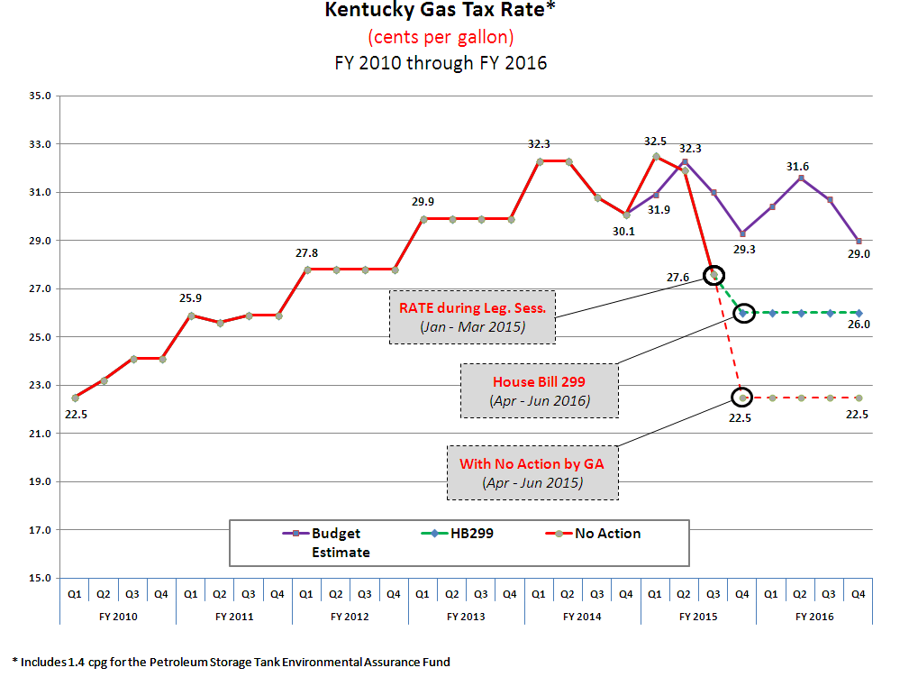
1 penny of the Gas Tax equates to approximately $30 million in Road Fund revenue. Even with the passage of HB 299, the Gas Tax still dropped 6.5 cents
per gallon in FY15. That equates to approximately $195 million (annualized basis) in lost Road Fund revenue, of which approximately $95 million would be
dedicated to Revenue Sharing, and $100 million would potentially be for state projects. The Gas Tax has been set at 26 cents per gallon for FY17 as well.

Slide 7
Road Fund Daily Cash Balance History and Projected Cash Balance Spring 2016
Notes:
In March of this year, if KYTC had continued the “business as usual” approach, the Cabinet was projected to face a NEGATIVE cash balance on the “low days” during the months of August, September, and October of this year, as well as an even more alarming projected negative balances in August 2017.
KYTC averages about $10 million per day in expenditures, and the Cabinet’s cash balance management plan strives to maintain a minimum available cash balance of $100 million at any given time.
With the potential projected “low days” being at a negative cash balance, the Cabinet had to make adjustments to reduce costs and had to paused the start of new state funded project phases.
The Cabinet’s ability to meet current financial obligations (“pay the bills”) and actual state road fund revenues, will determine the Cabinet’s ability to fund new state road project phases the during the FY 2017 – FY 2018 biennium.
The last time the cash balance neared zero was in 2004 when it hit $30 million. And like now, at that time KYTC had to make management decisions in reducing expenditures and had to delay the start of new state funded projects.

Slide 8
Road Fund Daily Cash Balance History and Projected Cash Balance Summer 2016 with Implementation of Pause 50
Notes:
Based on:
Maintenance expenditures from $401 to $370
$145 Million R/W and Utility Holds
The low actual August day was $117 Million.

Slide 9
Where does this leave KYTC Projects?
Reduction in Maintenance budget of $30 Million vs. FY 16 expenditures ($371 to $340 Million)
The Cabinet will continue with cost saving measures and closely monitor projected expenditures and projected available state funds.
We will continue commitments to mega projects using federal-aid highway funding
I-69 improvements
Mountain Parkway widening
U.S. 68/KY 80 roadway improvements
Louisville bridges
Federal-aid highway funding levels are sustainable (about $700 million per year).
The state resurfacing program will continue to be funded at $125 million per year.
Notes:
Back in February 2016, the projected FY 2016 maintenance cost had increased to $401 million, but with implementation of KYTC cost saving measures the actual FY 2016 maintenance cost at the end of June was $370 million.
But even with the implemented costs savings measures, our maintenance costs were still $30 million more than the FY 2016 budget amount of $340 million.
The Cabinet will continue with cost saving measures and closely monitor projected expenditures and projected available state funds.
Ongoing commitments to mega projects using federal-aid highway funding including I-69 improvements, Mountain Parkway widening, U.S. 68/KY 80 roadway improvements, and the Louisville bridges will continue.
Federal-aid highway funding levels are sustainable (about $700 million per year). The Cabinet will proceed on new federally-funded projects including the widening of I-75 in Rockcastle County, new I-65 interchange in Bullitt County and upgrading the William H. Natcher Parkway to interstate standards in order to establish the “I-165” Spur Route between Bowling Green and Owensboro.
The state resurfacing program will continue to be funded at $125 million per year.
The projected FY 2017 Rural Secondary revenue sharing program is approximately $330 million.

Slide 10
Questions?

Slide 11
Road Fund/Federal Fund Project and Maintenance-Related Spending

Slide 12
Summary of Authorized State Funded Projects by Phase
Phase | # of Projects/Phases | Amount | Percent
P | 18 | 2,826,452.51 | 0.3
D | 304 | 93,431,561.47 | 10.8
R | 183 | 164,968,146.45 | 19.1
U | 174 | 168,940,615.03 | 19.5
C | 390 | 434,184,457.26 | 50.2
Totals | 1,069 | 864,351,232.72 | 100.0

Slide 13
Economic Development Bonds
2005 GA Authorization (State) $300,000,000
2006 GA Authorization (State) $350,000,000
2009 GA Authorization (State) $400,000,000
2010 GA Authorization (State) $400,000,000
Program Total $1,450,000,000
*There is $125 million left in bonds to issue for Economic Development (Highway) projects.

Slide 14
Funding Status - Summary Economic Development Bond Project Accounts Life-to-Date through July 2016
 | Bond Project Accounts - SUMMARY
 | Available Budget:
 |  | Authorized Bond Funding | $1,450,000,000.00
 |  | Life-to-Date Interest on Bond Proceeds | 21,387,900.00
 |  | Project Underruns | 64,255,786.74
 |  | Revised Budget | $1,535,643,686.74
 | Uses of Budget:
 |  | 2005 Economic Development Bonds - JL01 | (313,891,308.00)
 |  | 2006 Economic Development Bonds - JL02 | (373,976,967.00)
 |  | 2009 Economic Development Bonds - JL03 | (424,078,534.00)
 |  | 2010 Economic Development Bonds - JL04 | (422,294,476.00)
 |  | Total Authorizations | $(1,534,241,285.00)
 | Total Available Balance |  | $1,402,401.74

Slide 15
GARVEE Bond Program
Interstate Widening - 2005 GA (HB 267) $150,000,000
Interstate Widening - 2006 GA (HB 380) $290,000,000
Louisville Bridges - 2008 GA (HB 410¹) $231,000,000
Louisville Bridges - 2010 GA (HB 3) $105,000,000
WKY Lakes Bridges - 2010 GA (HB 3) $270,000,000
Program Total* $1,046,000,000
*All GARVEE bonds have been issued for authorized projects and are under construction or completed.
¹ Amended HB 406

Slide 16
KYTC Other Talking Points KYTC “Toll Credits”
Since back in early 2000, KYTC has used federal “Toll Credits” as the required matching funds for federal-aid highway funding.
“Toll Credits” are not spendable dollars, they are credits earned by KYTC where state funds were used to pay expenditures for eligible federal funded activities.
With KYTC using “Toll Credits,” the federal-aid highway funded projects were funded with 100 percent federal-aid highway funding and no state spendable dollars were required as matching funds.
In December 2015, KYTC received notice from FHWA that the methodology that had been used by FHWA and by KYTC to calculate the yearly earned “Toll Credits” was not in compliance with federal regulations.
FHWA for several years had allowed KYTC to use ED Bonds in calculating maintenance of effort and allowed KYTC to claim them as “Toll Credits” in KYTC’s annual “Toll Credit” application to FHWA.
However, the FHWA Office in Washington, DC disagreed in Calendar Year 2015 with KYTC’s continued request for earned “Toll Credits” because they determined that the amount of “Toll Credits” earned must be based on a project that is being paid for with toll revenues.
As a result, FHWA removed approximately $650 million of “Toll Credits” and adjusted our existing “Toll Credits” balance to $372 million as of December 2015.
The projected remaining “Toll Credits” that KYTC can earn from the Toll Revenue Bonds and a TIFIA Loan for the Louisville-Southern Indiana Ohio River Bridges project is approximately $220 million.
KYTC will not be eligible to earn “Toll Credits” beyond Fiscal Year 2016, unless another project with a toll facility is constructed.

Slide 17
KYTC Other Talking Points KYTC “Toll Credits”
In the development of the 2016 Highway Plan, the use of the remaining “Toll Credits” were outlined as follows:
To be in compliance with bond documents and KYTC’s pledge to bondholders, $176 million of “Toll Credits” are scheduled as the required matching funds to cover the GARVEE Bond Debt Service payments through FY 2027.
The remaining $416 million of “Toll Credits” will be used as required matching funds for FY 2016 through FY 2019, and part of FY 2020.
In FY 2020 the remaining “Toll Credits” will be used, and KYTC will begin using state funds as the required matching funds.
The estimated amount of state funds required for the matching funds of federal-aid highway funds scheduled in the current Transportation Act is approximately $100 million per year.

Slide 18
KYTC Other Talking Points
2016 Draft STIP public review period ended August 16, 2016.
KYTC will review public comments, FHWA, and FTA review comments, and will prepare the final 2016 STIP for submittal to FHWA and FTA by September 1, 2016.
FHWA and FTA will conduct their final review and KYTC will make required changes in order to have an approved 2016 STIP by FHWA and FTA before October 1, 2016.
KYTC is working on programming the remaining FY 2016 federal-aid highway funding before October 1, 2016.

Slide 19
End of Fiscal Year Redistribution of Obligation Authority FY 2002 thru FY 2015
FISCAL YEAR | ADDITIONAL OBLIGATION AUTHORITY RECEIVED | KENTUCKY PERCENT OF TOTAL | TOTAL ADDITIONAL OBLIGATION AUTHORITY AVAILABLE NATIONWIDE
2015 | 37,323,159 | 1.96% | 1,906,572,178
2014 | 37,080,135 | 1.75% | 2,117,694,862
2013 | 27,863,195 | 1.75% | 1,595,648,530
2012 | 24,885,750 | 1.78% | 1,400,464,387
2011 | 22,877,247 | 1.93% | 1,182,665,012
2010 | 22,426,299 | 1.68% | 1,336,569,692
2009 | 16,988,869 | 1.65% | 1,028,541,567
2008 | 18,345,981 | 1.57% | 1,167,254,399
2007 | 19,029,829 | 1.56% | 1,223,675,007
2006 | 33,905,399 | 1.63% | 2,076,788,143
2005 | 17,434,289 | 1.49% | 1,167,701,604
2004 | 14,032,625 | 1.44% | 973,838,857
2003 | 6,471,721 | 1.50% | 432,391,111
2002 | 7,584,664 | 1.53% | 495,383,586
TOTALS | 306,249,162 | 1.69% | 18,105,188,935

Slide 20
Thank you!

